Slide 1
The Project and its Information
Changing Assay for Experiment

Slide 2
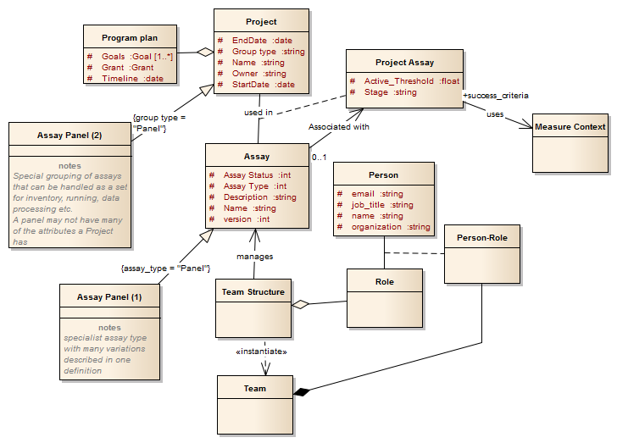
Project as a set of Assays

Slide 3
But…
An assay isn’t really a concrete thing, the experiment is the concrete thing. The concrete thing representing the assay is perhaps the protocol; an Assay is somewhat abstract.
An assay is class for an experiment – if you will, it’s metadata
So let’s swap assay and experiment in the Project Management area to keep real things in reality

Slide 4
Going back to basics
Experiment
Project
Assay (protocol)
Compounds
An Experiment occurs in the context of a Project (provides funding, organization, management etc.).
It uses an Assay to define how it is executed
And a set of Compounds which are submitted to test.
In the scope of a Project an Experiment yields knowledge and may generate a list of Compounds which can then be tested in further experiments

Slide 5
A project has several Aspects
Project
A Project has several “aspects” – people see different faces depending on their interests. Some see a core for security (access control) functionality, some see scientific advance through the progression of Experiments. Some see financial and organizational things like funding, teams, locations, etc.
BARD is concerned with the “scientific advances” aspect as knowledge is built up through the progression of a set of compounds through experiments.
Exprt 1
Exprt 2
Exprt 3
Exprt 4

Slide 6
Project as a set of Experiments

Slide 7
That was easy! But some questions…
Is the “hit threshold” part of the Experiment or related to the role of the Experiment in the Project?
If the experiment data is re-used in another project would the threshold be different?
Within the scope of a Project what is the relationship between two Experiments?
We probably need a relatively complex attribute/value pair structure unless we can get away with simple attributes in the Project_Experiment. Bearing in mind scientists proclivity for devising new concepts, ways of working, I think we need the flexibility of the attribute/value structure
How does the Assay behave in this – is there a meaningful relationship between the Project and the Assay.
I suspect there is but only at the planning time. If we state that BARD is tool for capturing and analyzing results, maybe we shouldn’t be capturing the planning. ‘Cos plans never match reality!
How do we handle one Experiment leading to multiple follow- on experiments?
I think the way to handle this is to make many Project_Experiment records between the starting Experiment and all the follow-on ones. Now we can have different criteria relating each experiment pair together. The existing structure handles this fine, though we may need a different Alternate Key.
An Experiment is the referencing entity for external systems.
This makes a better match with Pubchem and gives greater granularity and hence precision when cross referencing to external systems

Slide 8
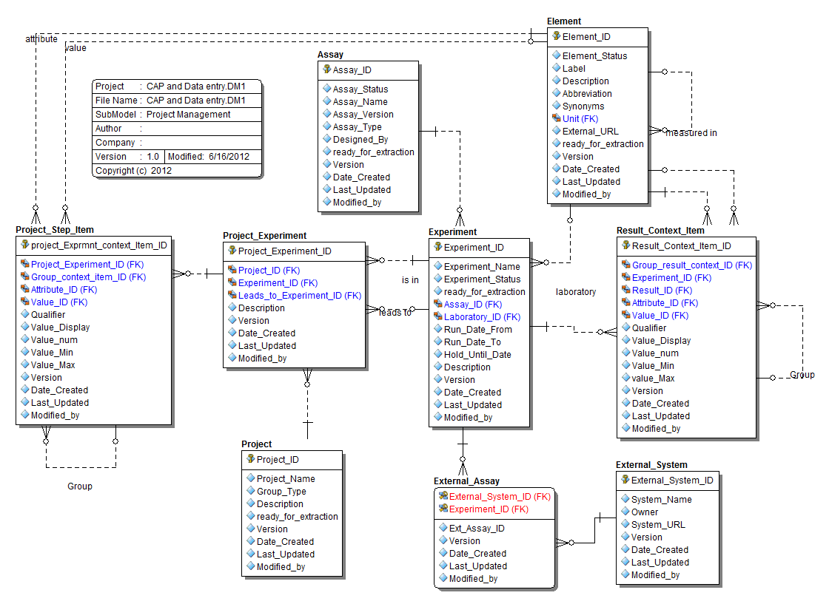
Data Model to capture this

Slide 9
DM description
External Assay
An experiment can be referenced only once in each external system (PubChem, CARS, etc.)
Several experiments can reference a single external assay (e.g. a PubChem AID may actually refer to several BARD Assays and Experiments. BARD does not allow that sort of grouping.
Project Step item
Using attribute/value format can use any items from the ontology (Element) to describe the relationship between the Experiment and the Project or the relationship between two Experiments in a Project
Includes Stage, Promotion Threshold, Promotion Criteria (these were moved out of the previous Project_Assay table)
Result Context Item
Can express the context for a single result (Result_ID is not null) or can express the context for the entire experiment (result_ID is NULL).
Attributes to describe the experiment context should be defined as Assay design time – otherwise, how do you know what you want to collect?

Slide 10
Assay Panel in the CAP
Other Effects:

Slide 11
CAP

